Slide 1
Mars In-Situ Resource Utilization for Health Applications
Santana Solomon, Hikaru Furukawa, Dr. Sara Walker
Arizona State University
Arizona NASA Space Grant Consortium Symposium
April 2022

Slide 2
INTRODUCTION
Central Question:
Are there chemical resources in space environments that can be used to aid human health during space missions?
Purpose:
Evaluate the potential of the resources on Mars for aiding human health during long-term space missions.

Slide 3
METHODOLOGY
2
4
1
3
Compare generated compounds to list of essential nutrients from WHO & Amboss databases
Classify compounds based on location and extraction information
Identify chemicals present on Mars from past missions & first detection papers
Utilize KEGG & JGI databases for list of all possible biochemical reactions

Slide 4
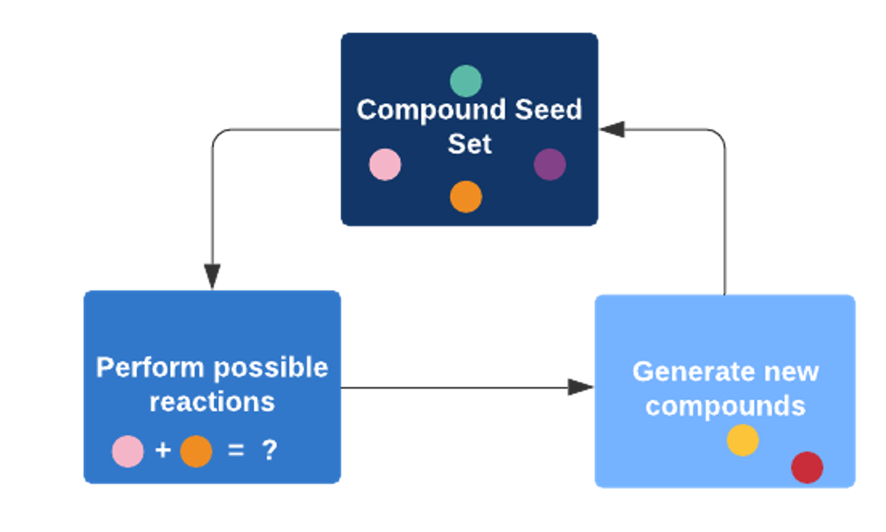
COMPUTATIONAL APPROACH
Utilization of a network expansion to test which essential nutrients can in principle be produced from Mars compounds
Starting from the initial seed sets, possible biochemical reactions are executed to generate new compounds, & are added to the initial list of compounds after each step
Process is repeated until no more reactions can be performed
Repeat

Slide 5
COMPOUND CLASSIFICATIONS
Compounds confirmed in multiple missions
Atmospheric compounds from all sites
Location specific compounds (Gale Crater, Gusev Crater, Meridiani Planum, & Ares Vallis)
Terrestrial compounds from all sites

Slide 6
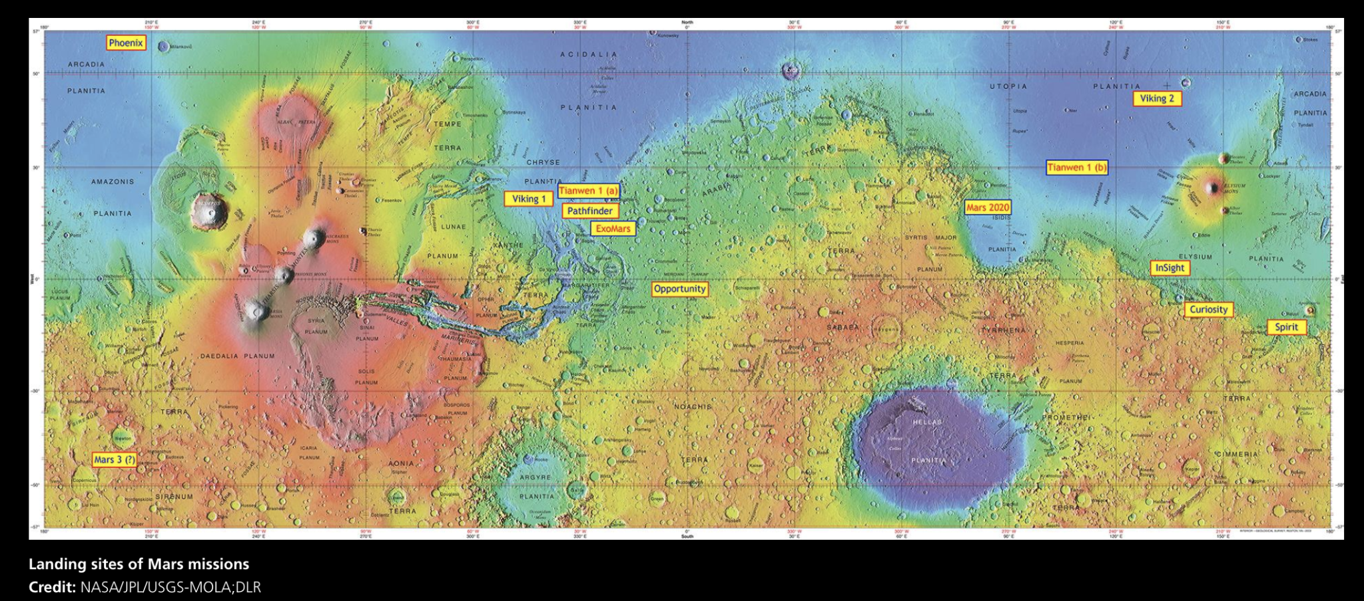
COMPOUND LOCATIONS

Slide 7
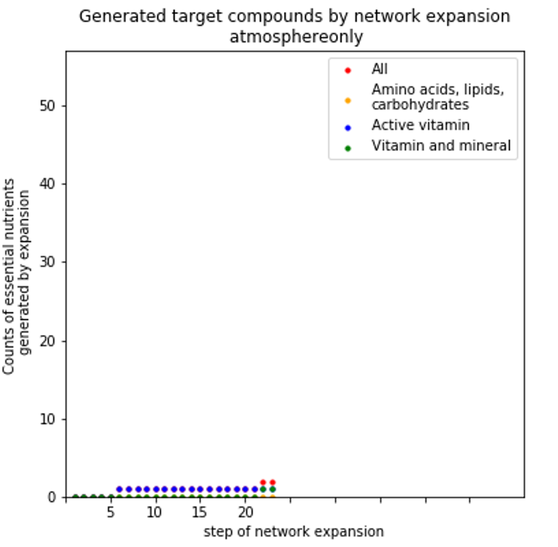
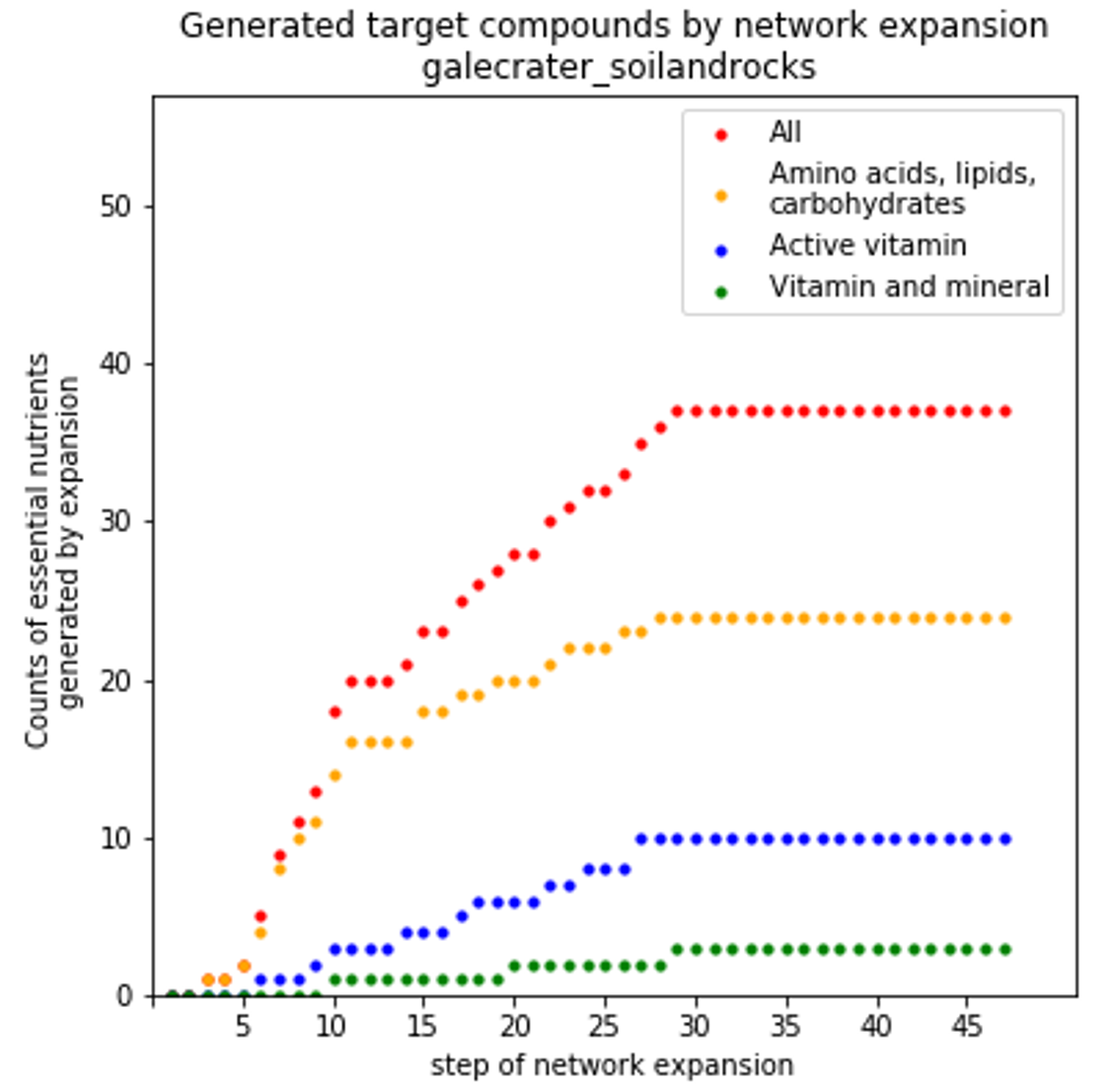
RESULTS
Generated Target Compounds by Network Expansion
Atmosphere Only
Gale Crater, Terrestrial
Number of essential nutrients generated by expansion
Number of essential nutrients generated by expansion
Step of network expansion
Step of network expansion

Slide 8
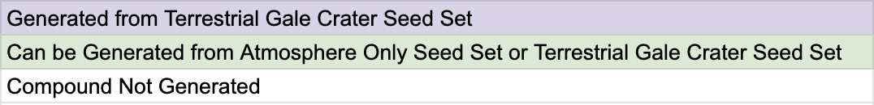
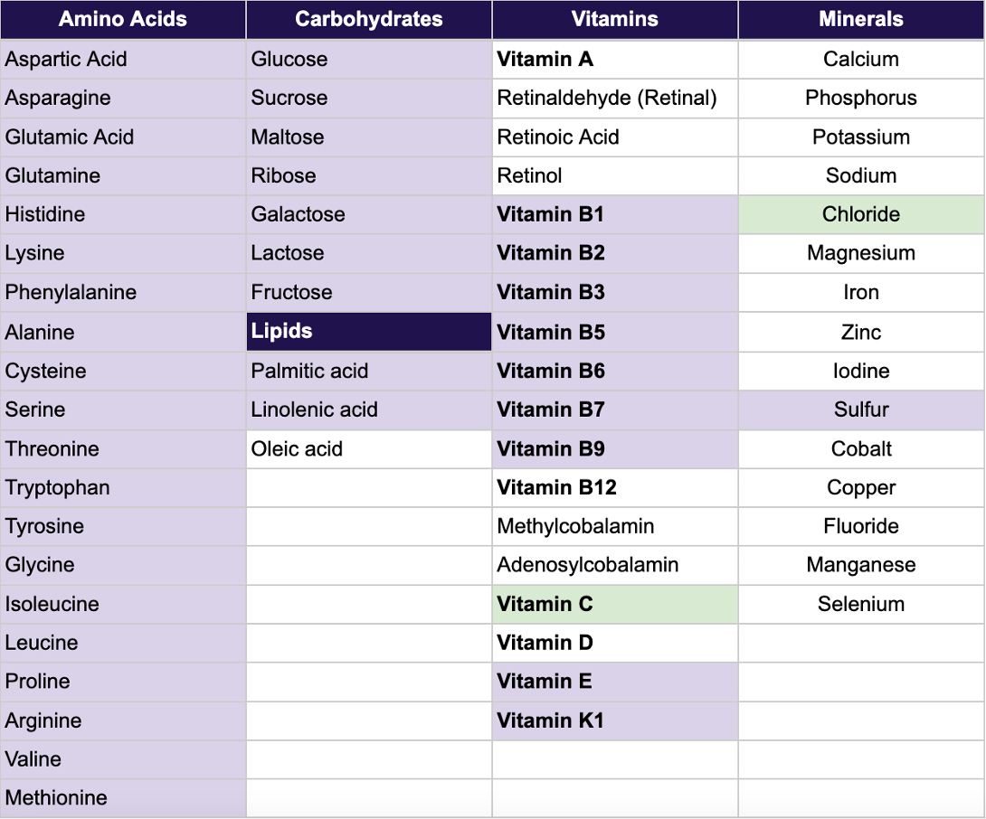
VITAMIN LIST COMPARISON
Generation of all 20 amino acids, several carbohydrates, lipids, & vitamins from terrestrial compounds

Slide 9
CONCLUSION
Amount and variety of producible compounds differ greatly by the choice of sites from which resources will be extracted
Resource abundant sites (e.g., Gale Crater) are more promising than the other sites such as Gusev Crater, Meridiani Planum, and Ares Vallis
Atmospheric compounds alone are not sufficient to support human health even under the most optimistic assumptions
Site selection is a critical factor for the future ISRU applications

Slide 10
REFERENCES
Wänke, H., Brückner, J., Dreibus, G., Rieder, R., & Ryabchikov, I. (2001). Chemical composition of rocks and soils at the Pathfinder site. Chronology and Evolution of Mars, 317-330.
Rieder, R., Gellert, R., Anderson, R. C., Brückner, J., Clark, B. C., Dreibus, G., ... & Zipfel, J. (2004). Chemistry of rocks and soils at Meridiani Planum from the Alpha Particle X-ray Spectrometer. Science, 306(5702), 1746-1749.
Gellert, R., Rieder, R., Anderson, R. C., Brückner, J., Clark, B. C., Dreibus, G., ... & Zipfel, J. (2004). Chemistry of rocks and soils in Gusev Crater from the Alpha Particle X-ray Spectrometer. Science, 305(5685), 829-832.
Ming, D. W., Archer, P. D., Glavin, D. P., Eigenbrode, J. L., Franz, H. B., Sutter, B., ... & Yingst, R. A. (2014). Volatile and organic compositions of sedimentary rocks in Yellowknife Bay, Gale Crater, Mars. Science, 343(6169).
Eigenbrode, J. L., Summons, R. E., Steele, A., Freissinet, C., Millan, M., Navarro-González, R., ... & Coll, P. (2018). Organic matter preserved in 3-billion-year-old mudstones at Gale crater, Mars. Science, 360(6393), 1096-1101.
Glavin, D. P., Freissinet, C., Miller, K. E., Eigenbrode, J. L., Brunner, A. E., Buch, A., ... & Mahaffy, P. R. (2013). Evidence for perchlorates and the origin of chlorinated hydrocarbons detected by SAM at the Rocknest aeolian deposit in Gale Crater. Journal of Geophysical Research: Planets, 118(10), 1955-1973.
Leshin, L. A., Mahaffy, P. R., Webster, C. R., Cabane, M., Coll, P., Conrad, P. G., ... & Grotzinger, J. P. (2013). Volatile, isotope, and organic analysis of martian fines with the Mars Curiosity rover. science, 341(6153).
Navarro-Gonzalez, R., Stern, J., Sutter, B., Archer, D., Mcadam, A., Franz, H., ... & Grotzinger, J. P. (2013, March). Possible detection of nitrates on Mars by the Sample Analysis at Mars (SAM) instrument. In 44th Lunar and Planetary Science Conference (LPSC 2013).
Freissinet, C., Glavin, D. P., Mahaffy, P. R., Miller, K. E., Eigenbrode, J. L., Summons, R. E., ... & MSL Science Team. (2015). Organic molecules in the sheepbed mudstone, gale crater, mars. Journal of Geophysical Research: Planets, 120(3), 495-514.
Gasda, P. J., Haldeman, E. B., Wiens, R. C., Rapin, W., Bristow, T. F., Bridges, J. C., ... & McInroy, R. (2017). In situ detection of boron by ChemCam on Mars. Geophysical Research Letters, 44(17), 8739-8748.
Forni, O., Gaft, M., Toplis, M. J., Clegg, S. M., Maurice, S., Wiens, R. C., ... & Dyar, M. D. (2015). First detection of fluorine on Mars: Implications for Gale Crater's geochemistry. Geophysical Research Letters, 42(4), 1020-1028.
Szopa, C., Freissinet, C., Glavin, D. P., Millan, M., Buch, A., Franz, H. B., ... & Cabane, M. (2020). First detections of dichlorobenzene isomers and trichloromethylpropane from organic matter indigenous to Mars mudstone in Gale crater, Mars: results from the Sample Analysis at Mars instrument onboard the Curiosity rover. Astrobiology, 20(2), 292-306.
Webster, C. R., Mahaffy, P. R., Atreya, S. K., Flesch, G. J., Mischna, M. A., Meslin, P. Y., ... & Lemmon, M. T. (2015). Mars methane detection and variability at Gale crater. Science, 347(6220), 415-417.
Stern, J. C., Sutter, B., Freissinet, C., Navarro-González, R., McKay, C. P., Archer, P. D., ... & Mahaffy, P. R. (2015). Evidence for indigenous nitrogen in sedimentary and aeolian deposits from the Curiosity rover investigations at Gale crater, Mars. Proceedings of the National Academy of Sciences, 112(14), 4245-4250.
Archer Jr, P. D., Ming, D. W., Sutter, B., Morris, R. V., Clark, B. C., Mahaffy, P. R., ... & Martin, P. (2018, December). Oxychlorine detection in Gale Crater, Mars and implications for past environmental conditions. In AGU Fall Meeting Abstracts (Vol. 2018, pp. P31F-3753).
Williford, K. H., Farley, K. A., Stack, K. M., Allwood, A. C., Beaty, D., Beegle, L. W., ... & Wiens, R. C. (2018). The NASA Mars 2020 rover mission and the search for extraterrestrial life. In From habitability to life on Mars (pp. 275-308). Elsevier.
Webster, C. R., Mahaffy, P. R., Atreya, S. K., Flesch, G. J., Mischna, M. A., Meslin, P. Y., ... & Lemmon, M. T. (2015). Mars methane detection and variability at Gale crater. Science, 347(6220), 415-417.
Thomas, N. H., Ehlmann, B. L., Meslin, P. Y., Rapin, W., Anderson, D. E., Rivera‐Hernández, F., ... & Wiens, R. C. (2019). Mars Science Laboratory observations of chloride salts in Gale crater, Mars. Geophysical research letters, 46(19), 10754-10763.

Slide 11
Thank you!

